Slide 1
C++
Beer Pub After Payment Management Program
Copyright ⓒ Slug. All right reserved.

Slide 2
01
Introduction
Why Topic
Requirements
Basic Concepts
Contents
02
Code Description
TREND OF POWERPOINT
Class Customer
Class Cashier
Else
03
Video
Example
Copyright ⓒ Slug. All right reserved.

Slide 3
01
Introduction
Why Topic?
Requirements
Basic Concepts
Copyright ⓒ Slug. All right reserved.

Slide 4
01
Introduction
Why Topic
Requirements
Basic Concepts
New Method of Management
Before
After
Waiter(Server) is required to take the order and serve it to the customer
Self-Service bar – Program required to take care of the management
Copyright ⓒ Slug. All right reserved.

Slide 5
01
Introduction
Why Topic
Requirements
Basic Concepts
Time Check
Maximum time is 2 hours
Time Check
Save Data
Calculation
Save Data
Name of the Beer
Volume (cc)
Hour
Min
Sec
Is Needs to be recorded every time the Customer refills
Void time_limit(tm *now)
Void record_beer()
Void record_time()
Private:
Void calculate_payment()
Public:
Void show_payment()
Calculation
Final bill will show:
For each type of beer, Name and the cost
Total Cost
Copyright ⓒ Slug. All right reserved.

Slide 6
01
Introduction
Why Topic
Requirements
Basic Concepts
While (customer.continue)
The while loop will continue to run until up to 2 hour. After the Void time_limit(tm *now) member function will change continue←0 , available to escape the while loop
Difficulty – from experience
Check Time- 63%
Save Data – File handling
Name volume time will be recorded into a txt file, making it easier for other class Cashier to access data easily
Calculation - 75%
File handling - 85%
Calculation – sorting Array
To calculate the cost of same type of beer, from a txt file, array is required.
Copyright ⓒ Slug. All right reserved.

Slide 7
02
Code Structure
Class Customer
Class Cashier
Else
Copyright ⓒ Slug. All right reserved.

Slide 8
02
Code Structure
Class Customer
Class Cashier
Else
void record_beer(){
}
//take in the number from the menu and take in the volume(cc)
void record_time(){
void time_limit(tm *now)
}
// record the current time
// compare the current time with the very first one. The very first time is read from the save_data.txt file
Copyright ⓒ Slug. All right reserved.

Slide 9
02
Code Structure
Class Customer
Class Cashier
Else
void load_cost_list(Cost_beer tmp[])
//load the cost list(name won/cc) and save it in to array
void show_cost_list(Cost_beer tmp[])
//shows menu
void show_save_data()
//shows every time the customer refills in time order
void show_payment(){
Private: void calculate_payment()
}
//shows final payment
//calculate the cost for each beer, sort in alphabetical order and save in final_bill.txt file
void get_payment()
//checks the bill
Copyright ⓒ Slug. All right reserved.

Slide 10
02
Code Structure
Class Customer
Class Cashier
Else
Main function structure
Defined outside as global
while (customer.Countinue)
{
cashier.load_cost_list(cost_list);
cashier.show_cost_list(cost_list);
customer.record_beer();
customer.record_time();
}
cashier.show_save_data();
cashier.show_payment();
cashier.show_payment();
typedef struct cost_beer
{
char name[16];
float won_per_cc;
}Cost_beer;
Cost_beer cost_list[14];
//data structure
//used to show the menue
Copyright ⓒ Slug. All right reserved.

Slide 11
03
Video
Example
Copyright ⓒ Slug. All right reserved.

Slide 12
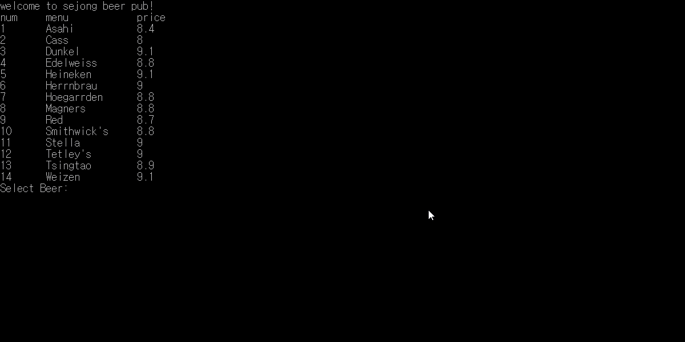
03
Video
Example
Copyright ⓒ Slug. All right reserved.

Slide 13
THANK YOU
C++
Copyright ⓒ Slug. All right reserved.

